Slide 1



Bioremediation of Insensitive Munitions Compounds
Jonathan Romero, Erika Rios (Postdoc), Reyes Sierra-Alvarez (PI)
Department of Chemical and Environmental Engineering
NASA Space Grant Symposium – 4/17/2021
Notes:
Good evening everyone! My name is Jonathan Romero, and I will be speaking to you all about the Bioremediation of Insensitive munitions compounds. My mentors are Dr. Erika Rios and Dr. Reyes Sierra of the ChEE Department. Next slide.

Slide 2
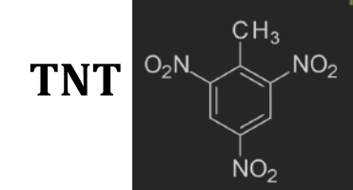
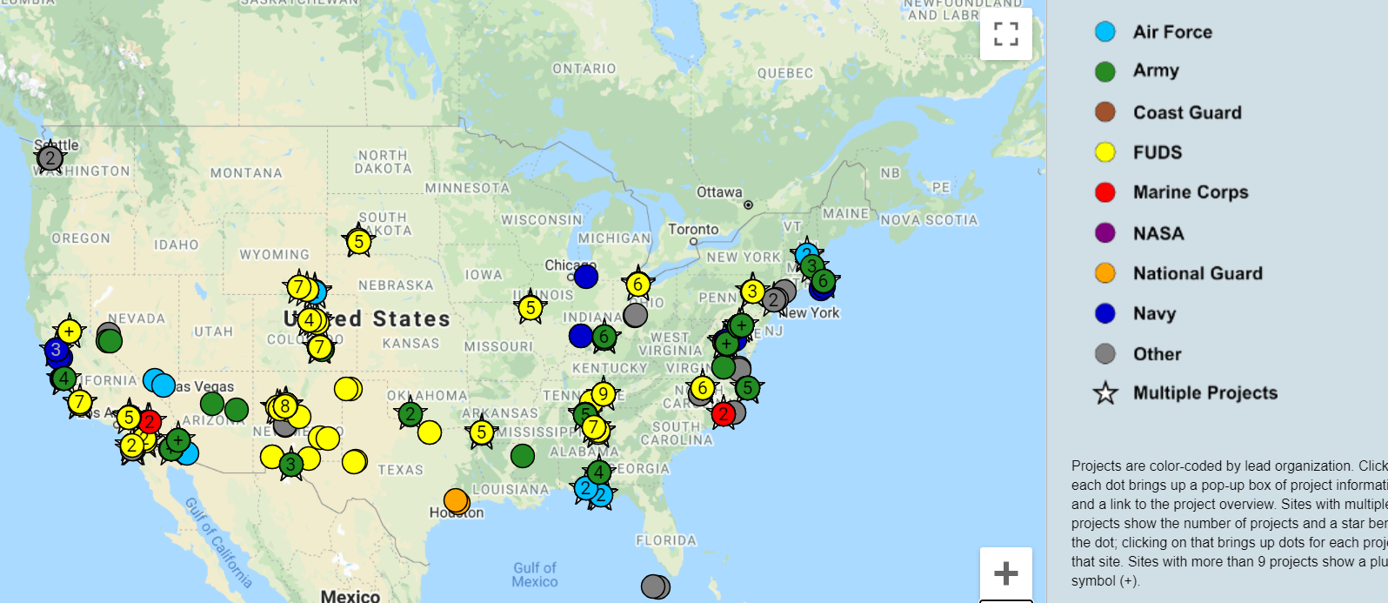
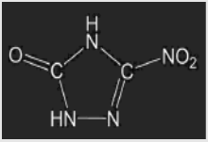
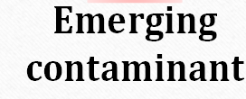
Problem Statement
Common explosives compounds are being replaced by insensitive munitions compounds.
Environmental emissions of these have become widespread in the USA – more hazardous in soils and groundwater.
Munition Response Sites
NTO
Source: SERDP & ESTCP (2020)
Notes:
Here is the main issue. Common explosives are being replaced by these emerging compounds known as Insensitive Munitions Compounds. RDX and TNT are some of the main compounds being replaced by these IMC’s, as these compounds have a higher chance of having an unwanted explosion. (3-nitro-1,2,4-triazol-5-one)NTO is the main replacement, but has become a widespread issue in the United States because it is actually more hazardous to soils and groundwater. The map below shows the regions at which certain corporations and military bases that have become aware of the issue and are working to fix the problem. Next slide.

Slide 3
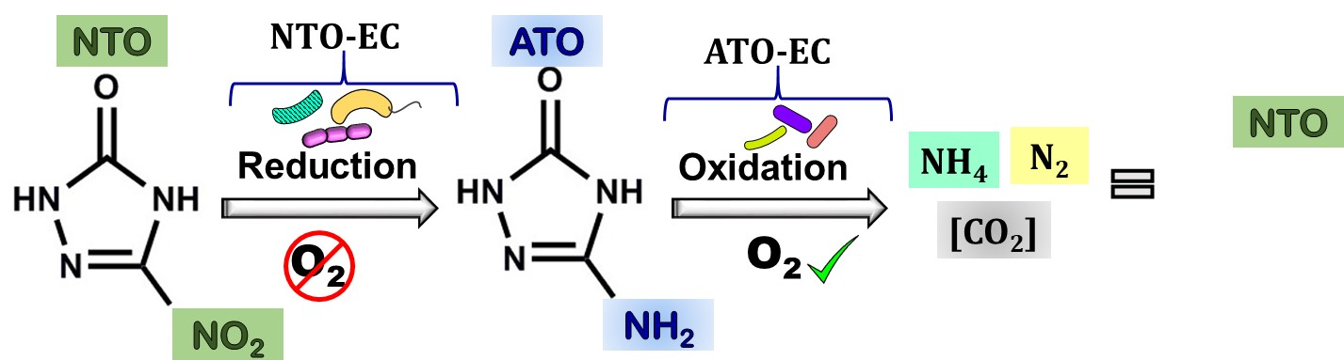
Objective
To demonstrate NTO bio-mineralization in soil reactors under different redox conditions (anaerobic/aerobic).
To demonstrate that an ATO-enrichment culture (ATO-EC) thrives in soil columns and that it attains full degradation of ATO.
Madeira et al., 2017
Notes:
The main objective is split into two main parts. One is to show that NTO can mineralize in soil reactors under different redox conditions, and the other is to show that an enrichment culture of the mineralized form of NTO, ATO, (3-amino-1,2,4-triazol -5-one) can thrive in soil and ideally degrade ATO. Diagram shows a simple redox reaction and conditions at which the compounds are degraded. Next slide.

Slide 4

Methods of Analysis
Batch assays inoculated with soil and enrichment cultures
NTO/ATO-degrading bioreactors (flow-through experiments)
Anaerobic reactor fed NTO
Aerobic reactor fed ATO
Objective: Attain NTO/ ATO-degradation in each reactor
Phase I
Anaerobic + Aerobic (sequential reactors) Influent of the 1st reactor contains NTO,
Objective: Attain full removal of NTO/ ATO
Phase II
Notes:
To complete this, batch assays were conducted in serum bottles. These assays were completed in two main phases. Phase 1 was to fully attain degradation of both ATO and NTO under their specific conditions. Phase 2 was to complete sequential biodegradation between the reactors to attain 100% removal of both NTO and ATO. Bioreactors themselves are being operated via continuous flow. Next slide

Slide 5
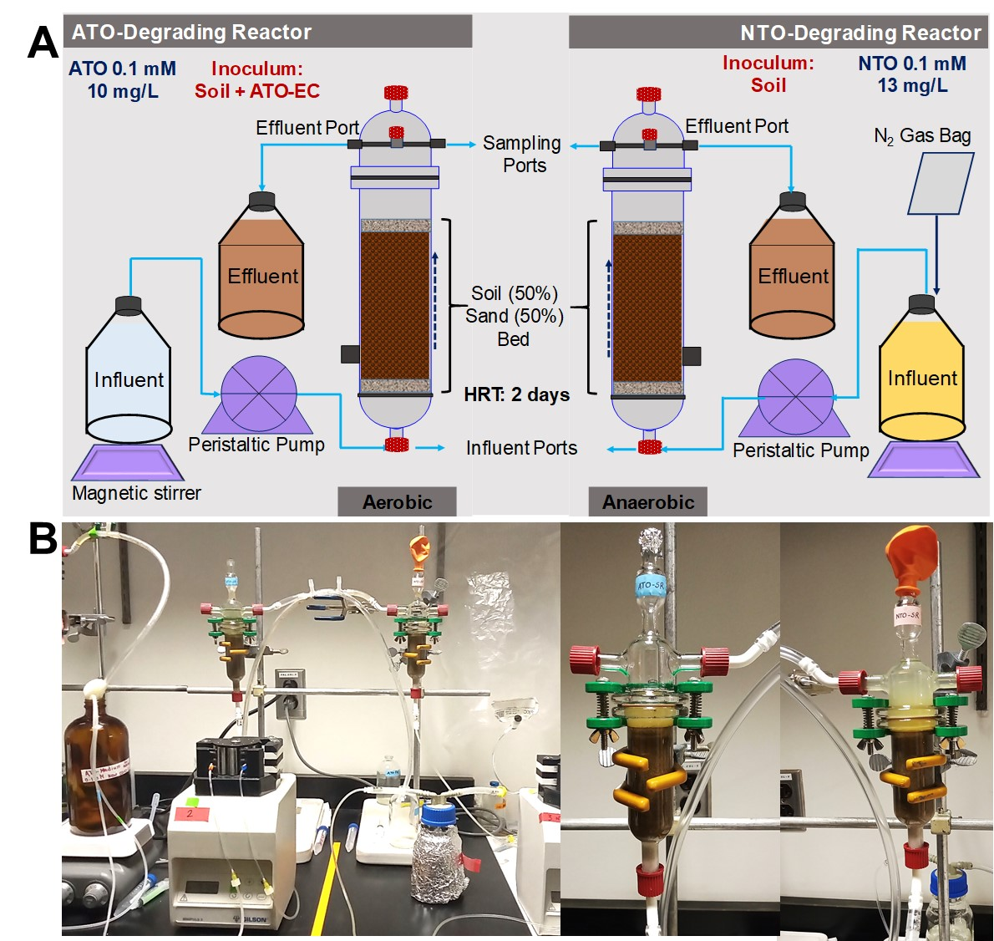
Notes:
Here is a schematic/picture of the bioreactors I worked with. On the top left, you see the ATO bioreactor, and on the top right you see the NTO bioreactor. Essentially sand and soil were packed into columns, and set up so that the NTO bioreactor would undergo anaerobic conditions and ATO would undergo aerobic conditions. Next slide

Slide 6
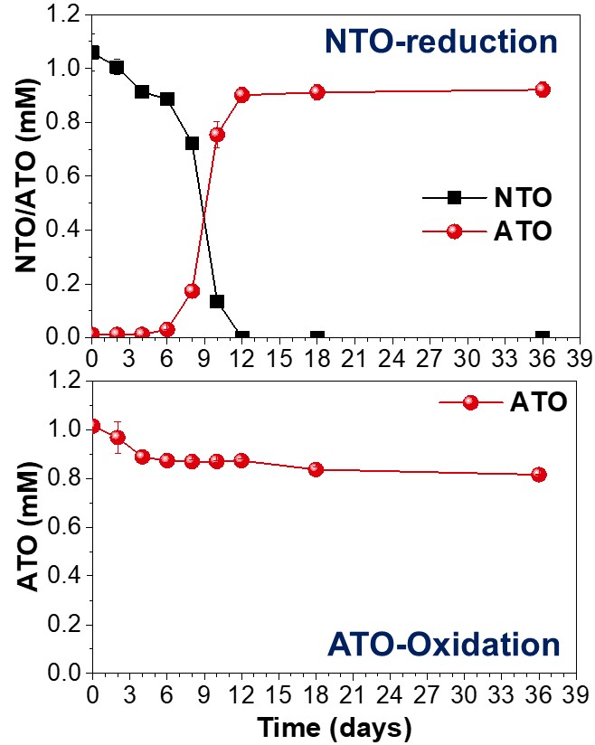
Results
Anaerobic batch assay:
NTO easily degrades to ATO
Acetate : 2 mM
NTO : 1 mM
Inoculum: Soil 1% w/vol
Batch Bioassays with Soil
Aerobic batch assay:
Soil community did not degrade ATO
ATO : 1 mM
Inoculum: Soil 1% w/vol
Soil bio-augmentation with ATO-enrichment culture was required
Notes:
For Phase 1, we can see that we achieved 100% removal of NTO from the anaerobic batch assay, but ATO was hardly removed at all. This lead to Phase 2 of experimentation, bio-augmenting the soil with ATO-EC. Next slide.

Slide 7
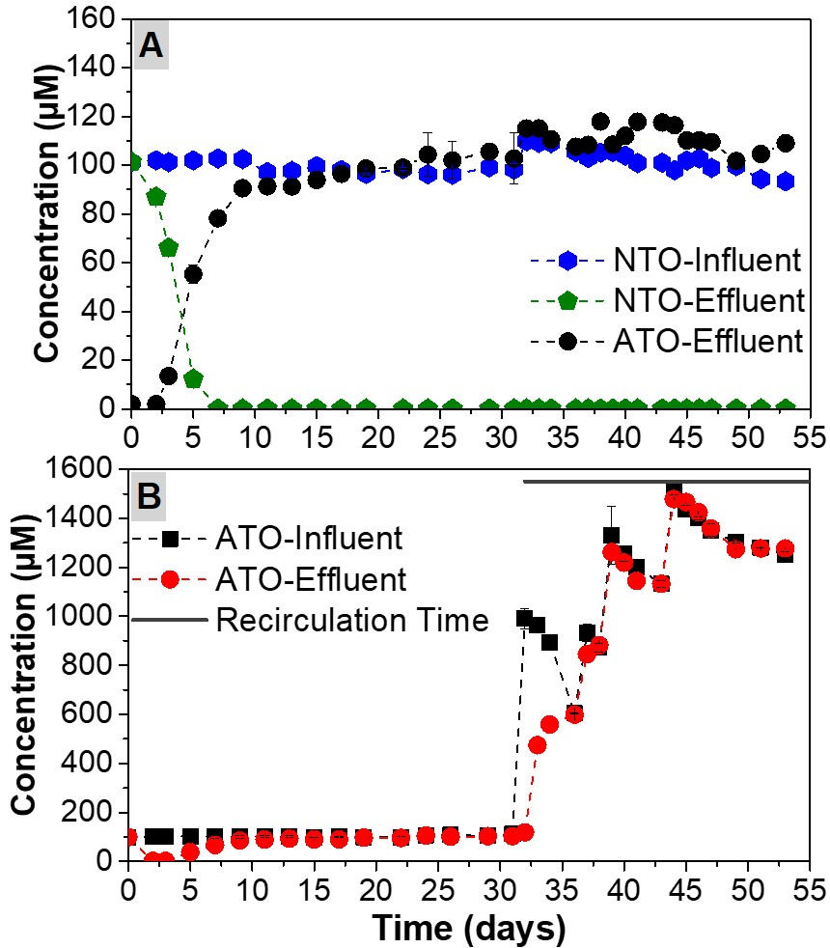
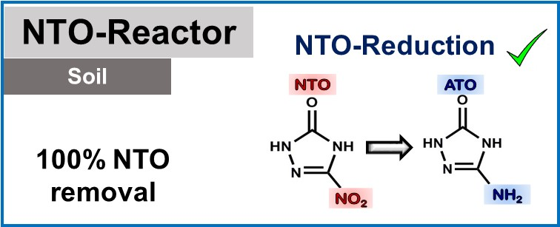
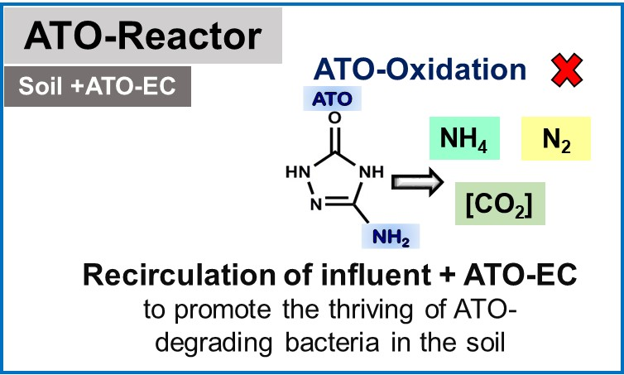
[NTO]= 100 µM
[ATO]= 100 µM
Notes:
However, even after bioaugmentation, ATO was not able to be degraded. We additionally tried recirculating the influent and the EC to promote the ATO-EC degrading bacteria, yet there have not been any promising results. Next slide

Slide 8
Interpretation of Results
NTO can be degraded to ATO easily by the soil microbial community.
ATO is much more resistant to degradation
The enrichment culture may not be viable in the bulk soil after bio-augmentation
DO in influent (≈ 7 mg O₂/L).
O₂ supply is limited in the soil-columns
C₂H₄N₄O + H₂O + O₂ + 2H⁺ → 2CO₂ + N₂ + 2NH₄
_{ATO}
Notes:
To give a basic interpretation, NTO can be degraded quite simply by the soil microbes in both batch assays and the NTO-degrading reactor. ATO is far more difficult to degrade. A few things to consider looking forward is that the enrichment culture we are using may or may not be able to work in the soil. Also, dissolved oxygen in the soil may be a limiting factor. There may not be enough O2 in the column to help attenuate the degradation of ATO. Next slide.

Slide 9
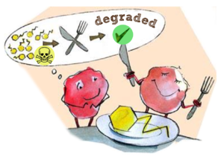
Conclusions / Impact
In batch bioassays, specialist bacteria can degrade hazardous contaminants such as NTO and ATO into benign mineralized products (e.g. CO₂).
NTO was also readily degraded to ATO in soil-columns. More research needed to demonstrate the degradation of ATO in soil-columns.
Demonstrating microbial mineralization of NTO in soil-columns is important since they simulate NTO bioremediation in natural contaminated soils.
Notes:
In conclusion, we have found from batch bioassays that there are some unique bacteria that can degrade these IMCs into the inert products. NTO is easily degradable in soil, but ATO is much more difficult. More research needs to be made to demonstrate ATO biodegradation.
Demonstrations of these mineralization's in soil is important as they help model real bioremediation occurring in the natural soils. Next slide.

Slide 10

Acknowledgements
Dr. Erika Rios
Prof. Reyes Sierra-Alvarez
Funding agencies
Thank you!
Notes:
I would like to thank Dr. Reyes Sierra and Dr. Erika Rios for the opportunity to be part of this research project, as well as the Arizona Space Grant Consortium. Thank you!

